Slide 1
By Jennifer Pickerill, Kenya Hokanson, Svein Hardaway Period 5 Intro to Marketing

Slide 2
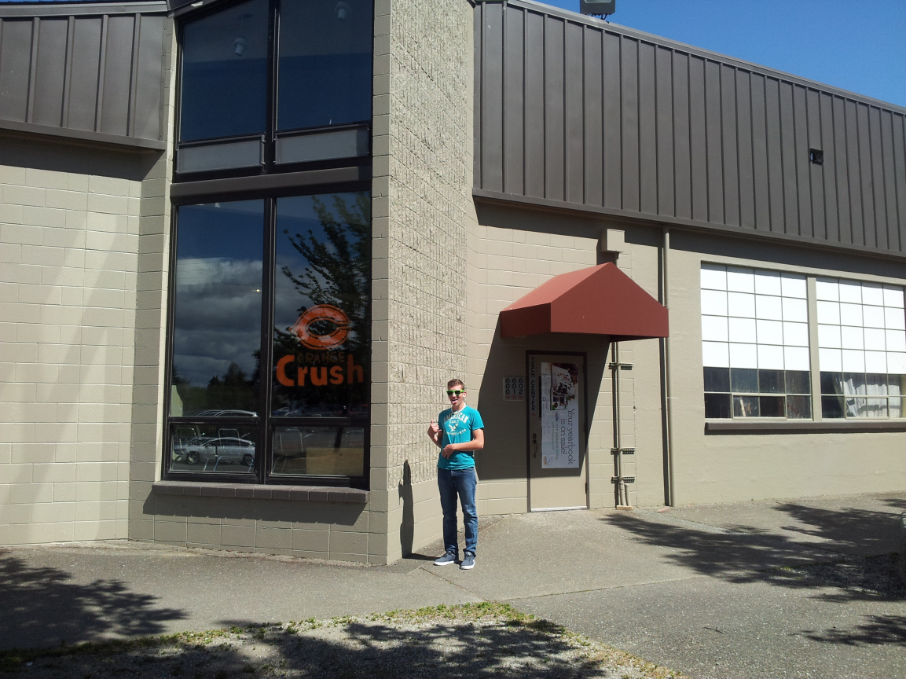
Located inside the Tech Center of Crater High School
Open during lunch.
Ran by volunteer Crater students

Slide 3
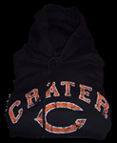
The C-Mart sells many items including:
Food (Mac&Cheese, candy, chips, muffins, etc.)
Drinks (Gatorade, water)
Crater fan gear (sweatshirts, t-shirts, bags, etc.)

Slide 4
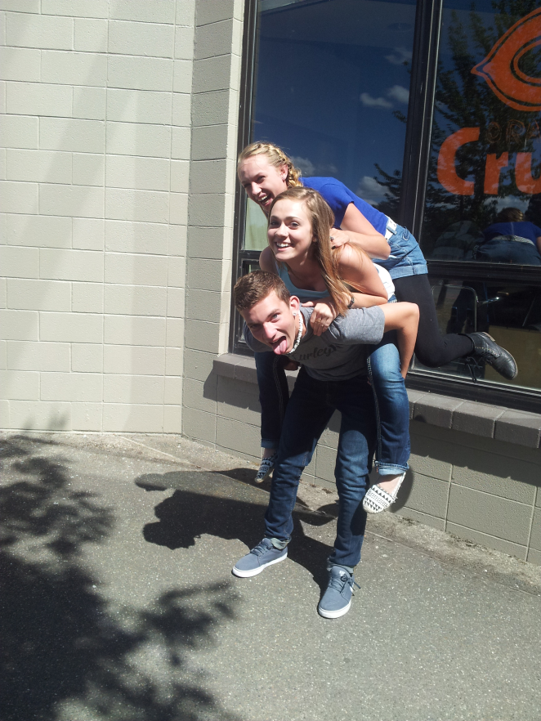
We are the Economic Boosters
Our goals are:
-To have C-Mart be better known
-Expand C-Mart
-Earn more money for school activities and clubs
Mission Statement: It is our mission to bring spirit and funding to all Crater High School activities.

Slide 5
Value Added : Competitions and promotions.
-Raffle Tickets at games for Crater gear
-Biggest fan competition at games with Crater gear
-Punch Cards
-And... Much more!!
We will start this new plan starting the new school year of 2013

Slide 6
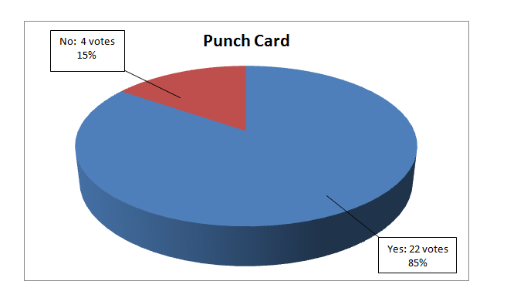
Crater High Schools C-Mart

Slide 7
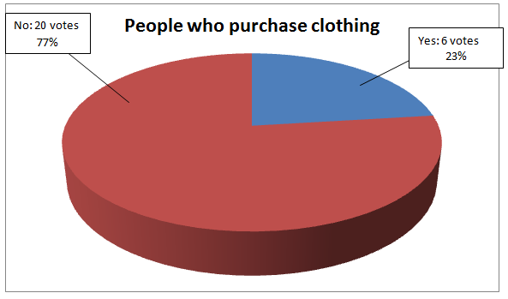
Crater High Schools C-Mart

Slide 8
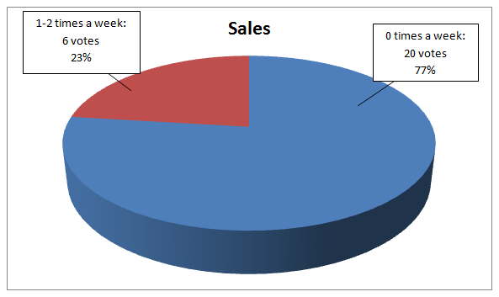
Crater High Schools C-Mart

Slide 9
Why are we doing this?
-Make more money for events.
-Sell more products.
-Have more customers.
-Create more school spirit.

Slide 10
Our current target market is Crater High School students
This includes 9th graders to 12th graders.
-We want to expand not only to students but Crater Fans who attended Crater athletic events
-Booths at games
-Vendors at games

Slide 11
Our current competitors are 7-11 and Fair City Market
Weaknesses
Far from school
Does not sell Crater gear
Strengths
-Reasonable cost on food
-Good customer service

Slide 12
Our current weaknesses and Strengths
Weaknesses
Not able to always be open
Small target market
Strengths
-On campus of school
-Offers exclusive Crater gear
-Reasonable prices

Slide 13
Products and Price

Slide 14
Place and Promotion
- Not only sell in actual C-Mart but also at athletic events with booths and venders.
- Having competitions for biggest fan, discounts, raffle tickets, punch cards, and more publicity.

Slide 15
